Slide 1
NOT ANOTHER ONE
By Peter Keres

Slide 2
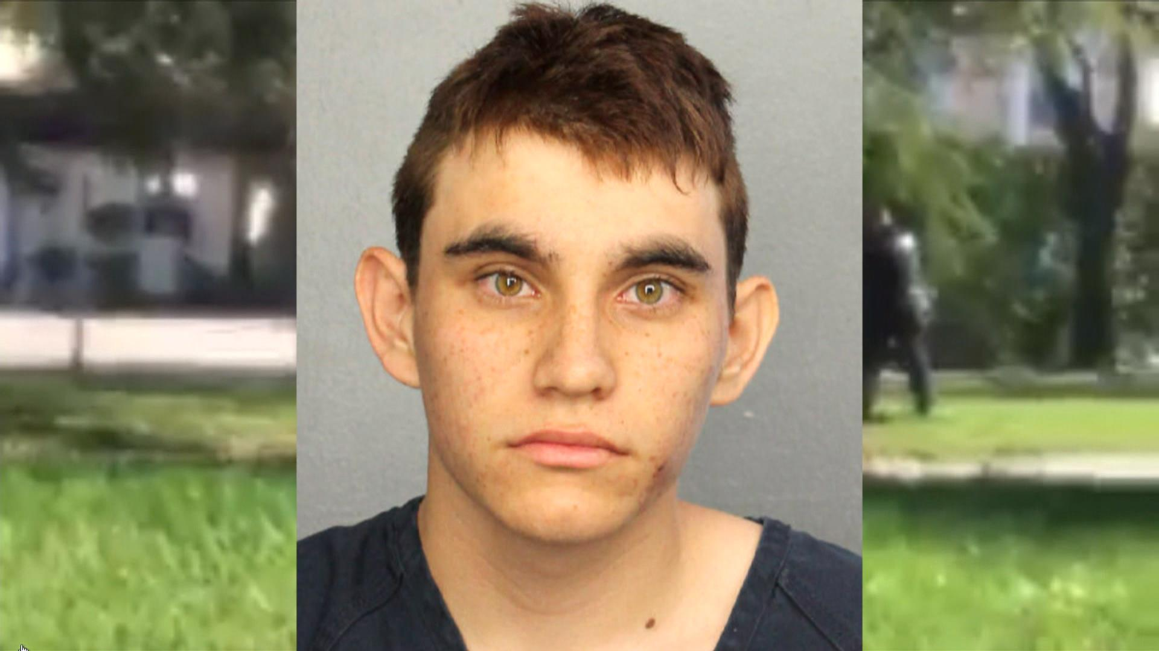
Parkland, Florida Marjory Stoneman Douglas High School
Nikolas Cruz, 19 years old

Slide 3
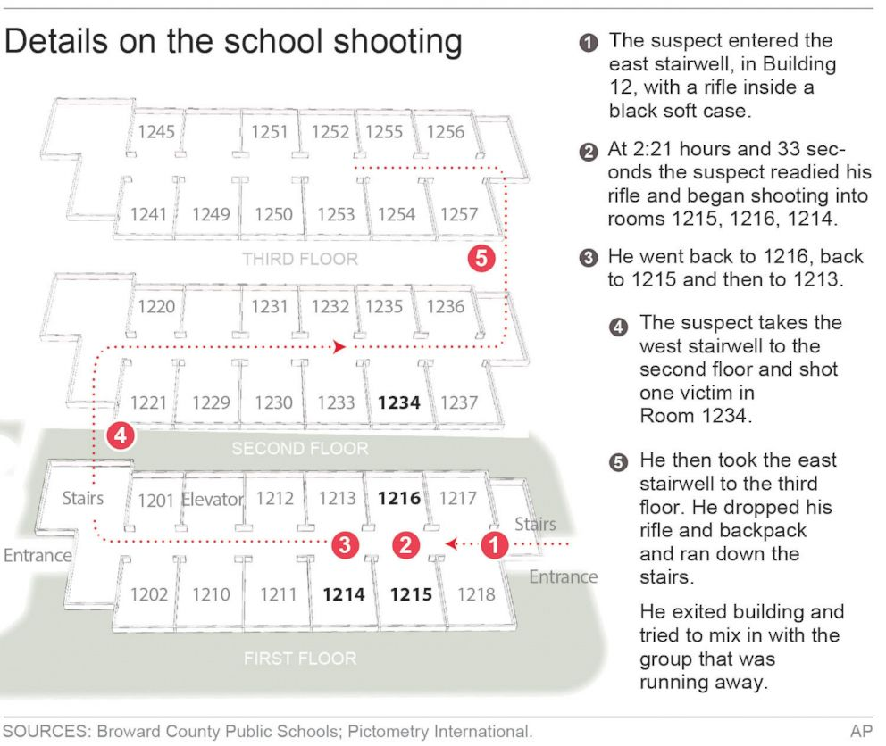
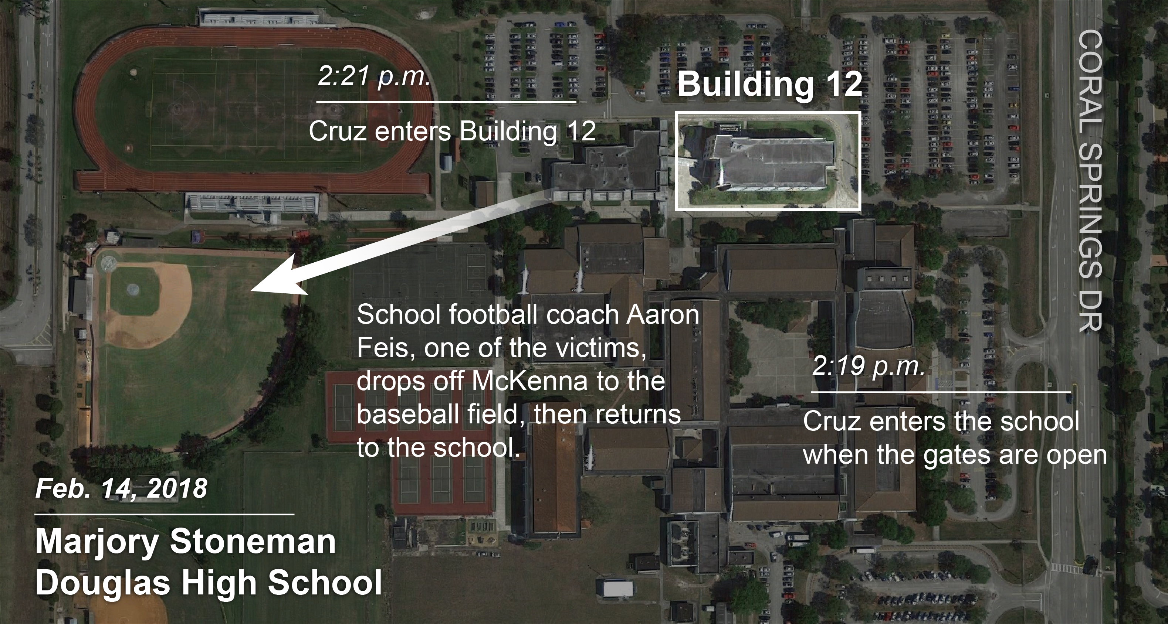

Slide 4
WAS HE CHECKED: no, Even though staff did report him walking with a large bag. HOW HE GOT ON PRPERTY: weapons in a black bag and used a taxi to get on the property. TIMELINE: Was at the school for 2 minutes before the shooting started. After 10 minutes the shooting was over and he left the school. CASUALTIES: 17 killed and 15 injured. Total victims 33.

Slide 5

Blacksburg, Virginia Virginia tech
Seung-Hui Cho, 23 years old

Slide 6
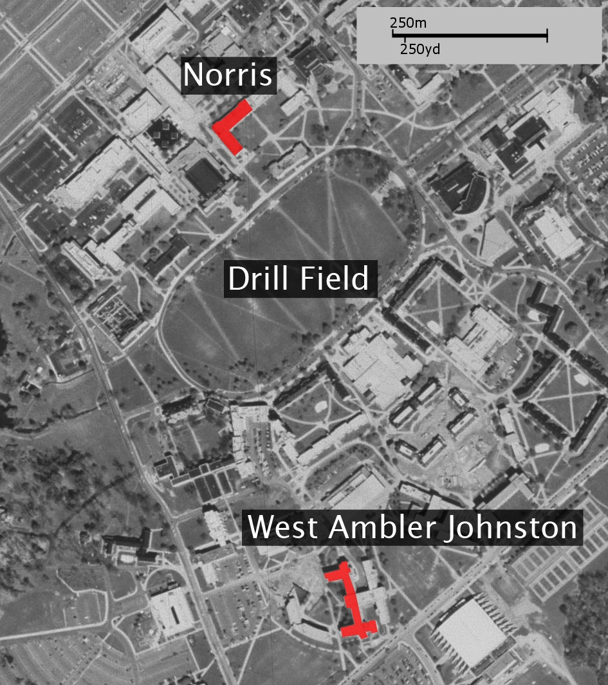
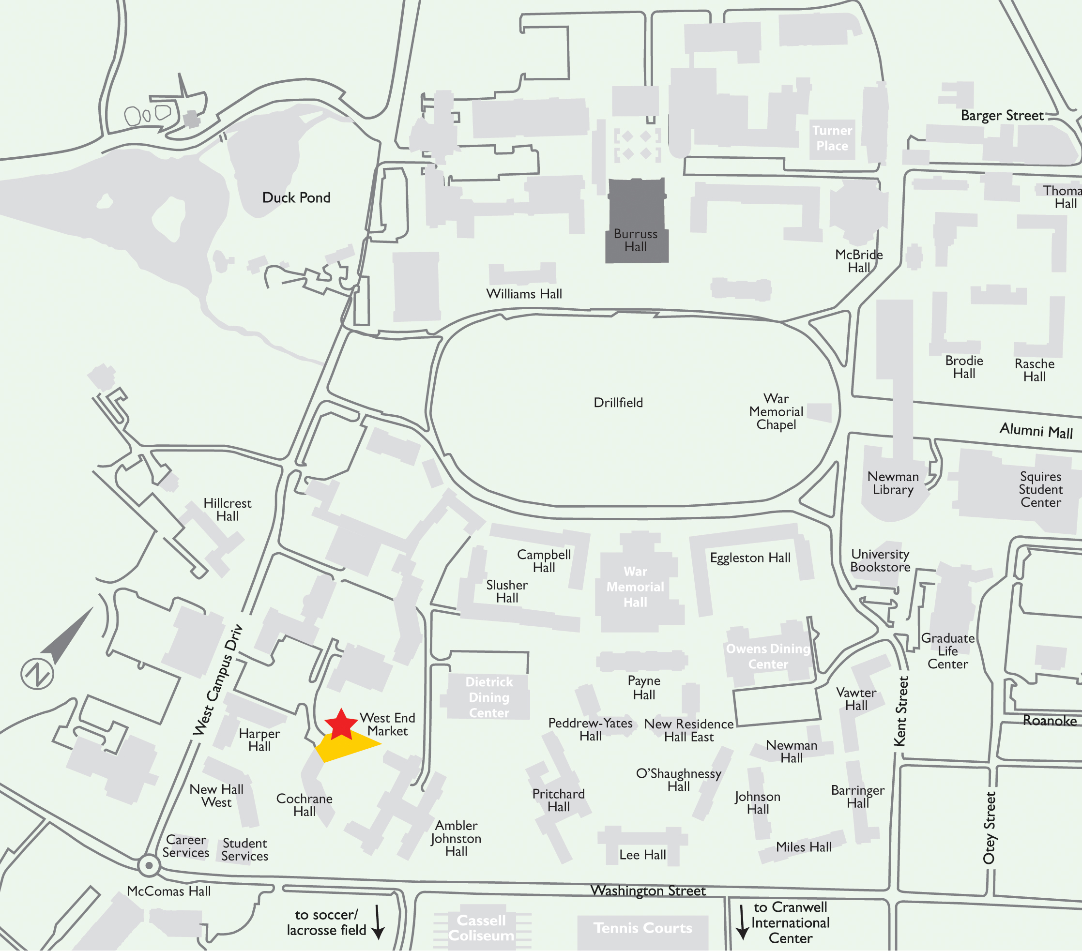
750 yd

Slide 7
WAS HE CHECKED: no, even though he was able to carry chains to lock doors, 2 guns, multiple knives, and over 150 rounds of ammunition across campus for over 2 hours. HOW GET GOT ON THE PROPERTY: The guns where purchased at a local pawn shop and kept hidden in his dorm for 2 months till the shooting happened.

Slide 8
TIMELINE: First shooting was at harper hall. Then left school to mail a package. Returned 2 hours later for the second shooting at Norris hall which lasted 11 minutes. CASUALTIES: 32 killed and 17 injured. Total victims 49.

Slide 9
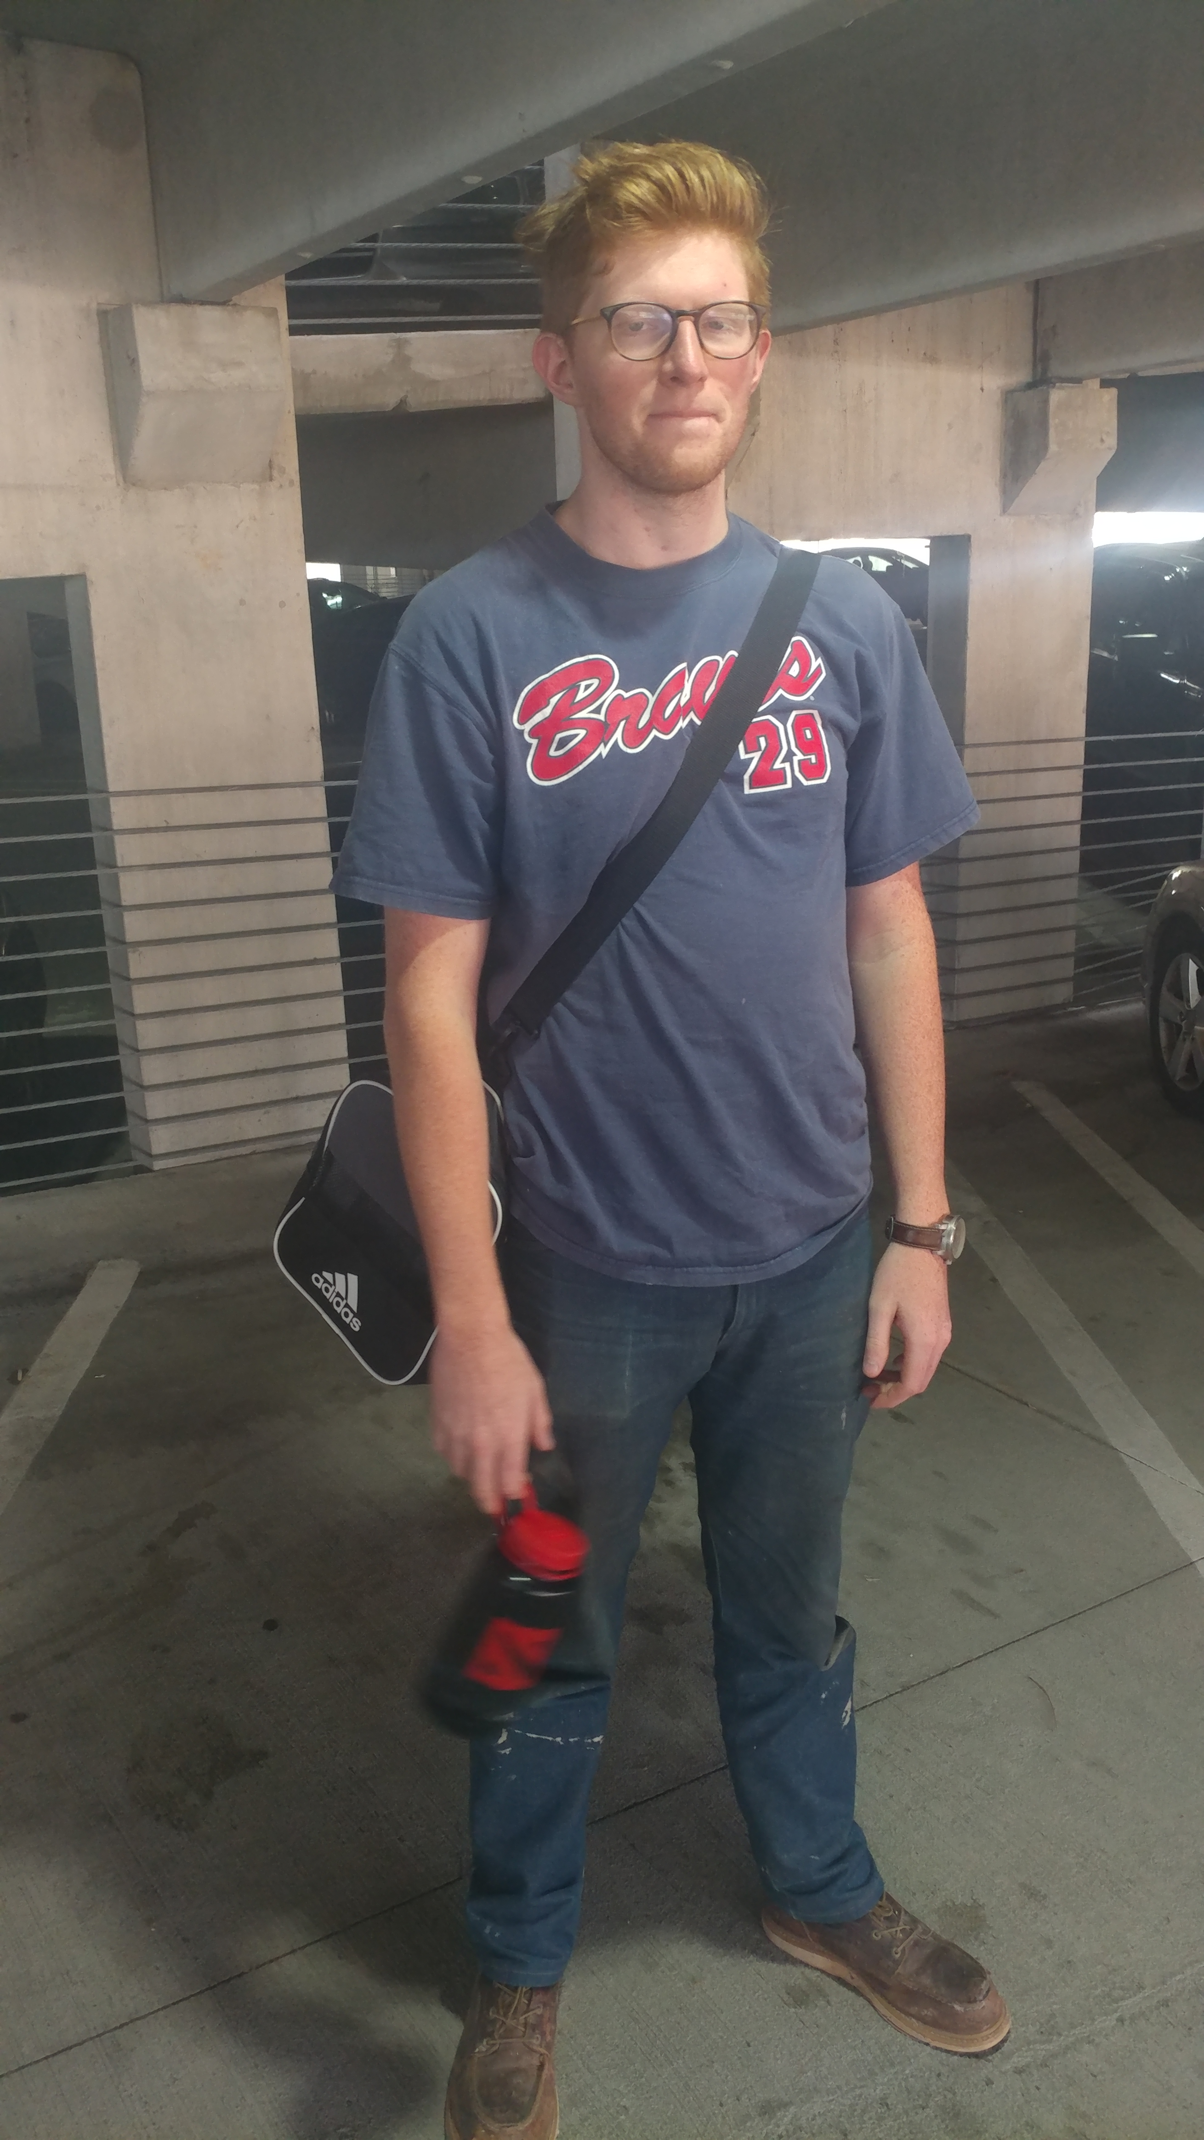
“What could happen” Columbus State University
Christian Hayes, 21 years old

Slide 10


Slide 11
WAS HE CHECKED: no, Has no reason to be on the campus and was carrying a large duffle bag. TIMELINE: arrived at 1:05 pm, walked to university hall at 1:10 pm, then the Davidson student center at 1:15 pm, and finally the outdoor cafeteria eating area at 1:20pm. POTENTIAL CASUILITES: 26 at university hall, 67 at Davidson, and 87 at cafeteria. Total of 180 victims.

Slide 12
“The clock tower watch” A Two system approach of a physical and software proactive layer.
TSA style check points around campus as the physical layer
Each checkpoint has a program that will gather information to send to a dispatcher which will allow them to see who is coming in and out and who is carrying as the software layer

Slide 13
“the TSA system works!” Over 700 million people was checked by the TSA in 2015. Capturing more than 2,600 firearms while maintaining a less then 20 minute wait for 98 percent of their passengers

Slide 15
750 yd

Slide 16
“The beauty of flexibility “ Option 1

Slide 17
PROS
CONS
Fast lines
No chance of multi building attacks
Fast time to implement
Can be spun as “giving jobs to the local community”
Now having a workforce to pay for
Could raise student tuition
does not protect the “open” areas of campus
students may be annoyed with being check multi times a day

Slide 18
“The beauty of flexibility “ Option 2

Slide 19
PROS
CONS
Keeps “open campus” feeling
Is the most secure
The fence can be used for other purposes, like a running track along the side or be painted by art majors
A light work force is needed
Major expense
Long time to implement
Creates a longer wait due to funneling everyone thought one check point
Could paint the school as a “target”

Slide 20
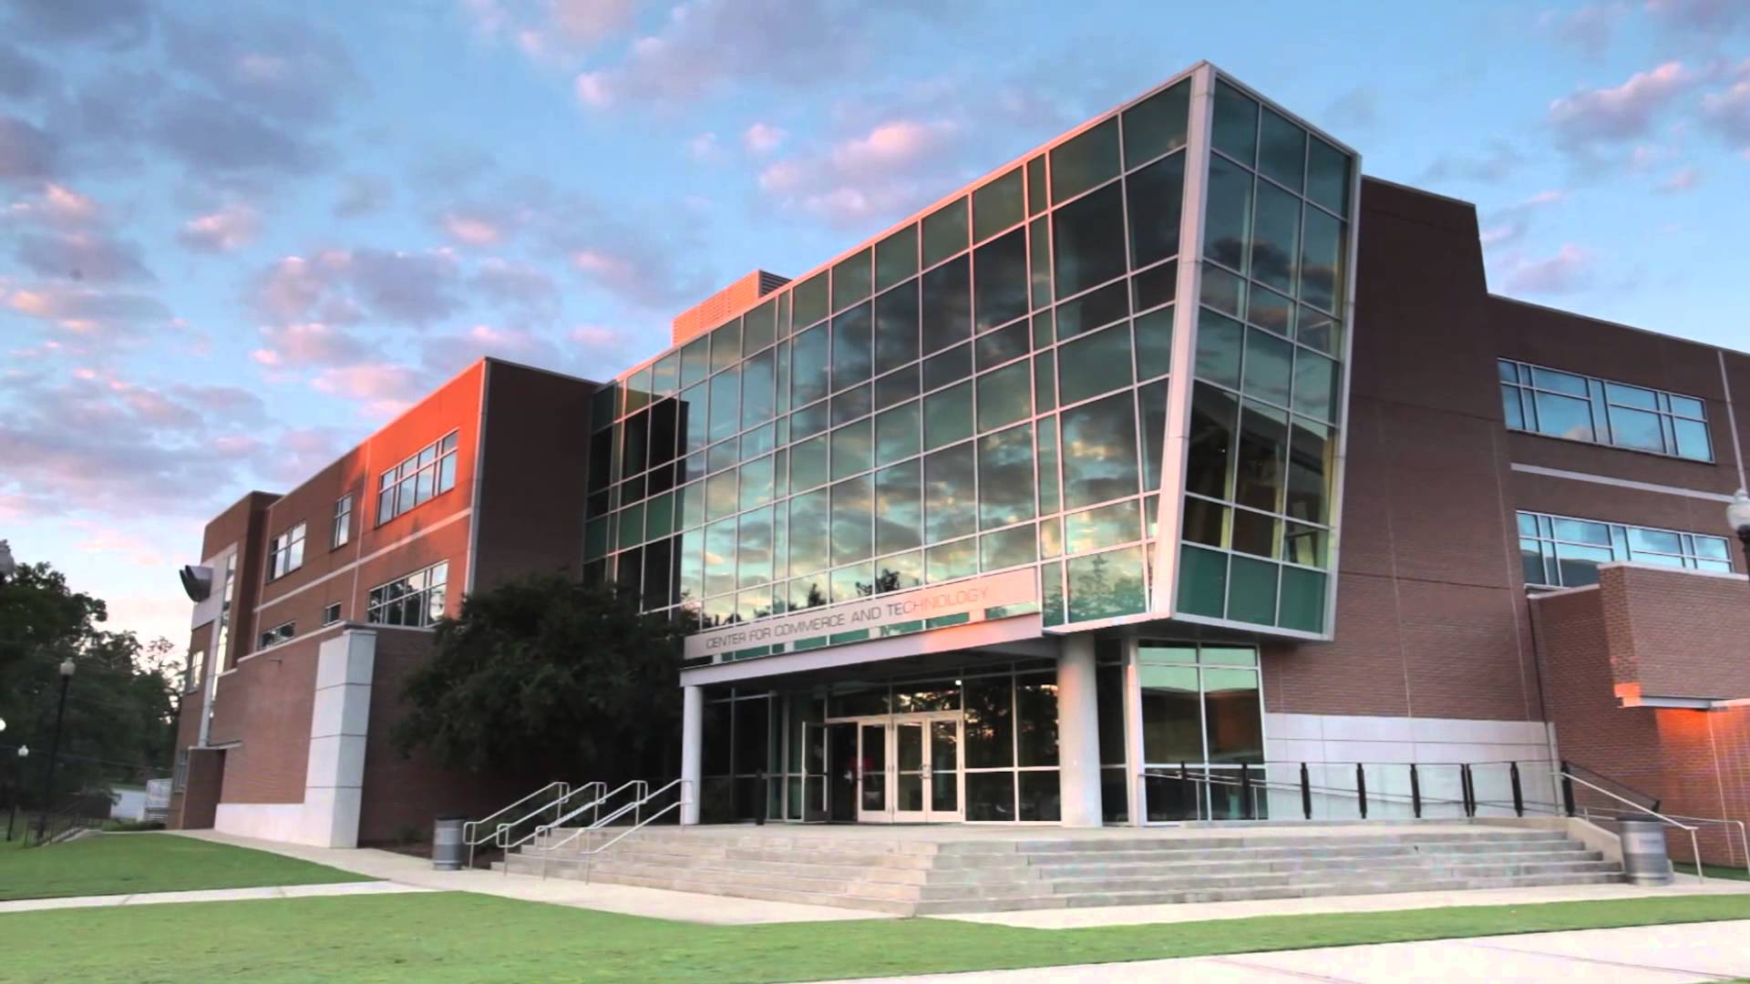

Slide 21
“happiness for both party's”
PRO GUN REFORM
CURRENT GUN OWNERS
Will cut down on gun related violence
Will make them feel as though they have made steps towards gun reform
Allows gun owners to still carry on campus
This plan does not infringe on current gun laws

Slide 22
What does this system give us
The officers will be directed in areas that an event could happen. This will reduce the response time from 10 minutes.
Still allows visitors to come to the school whenever they wish
Keeps the school in a neutral position on the gun reform debate
Allows flexibility based on the school’s budget
Lets the school act in a faster fashion and have more control instead of waiting for government intervention.

Slide 23


Slide 24


Slide 25
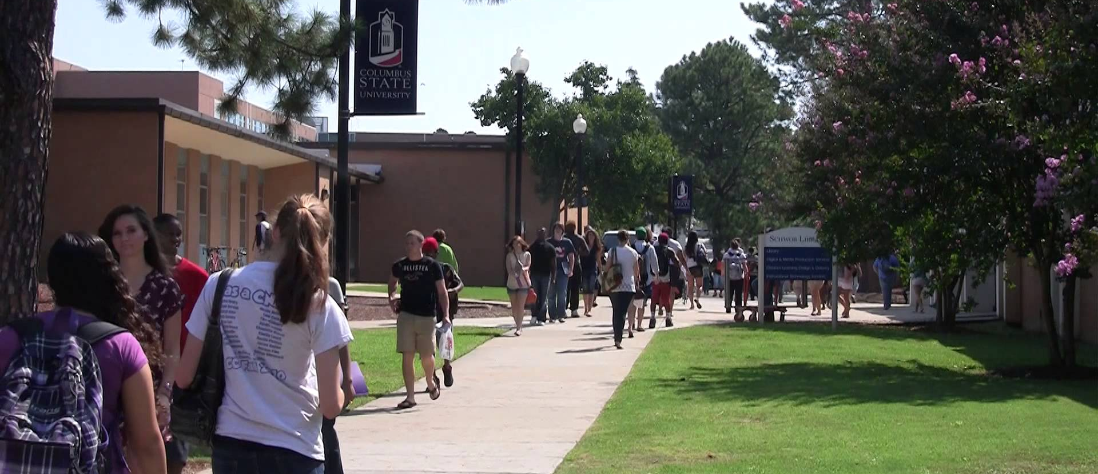

Slide 26
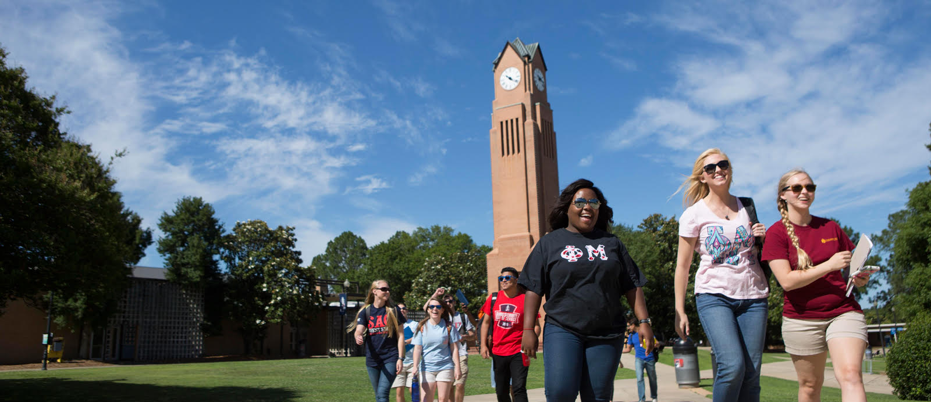

Slide 27
References
https://www.cnn.com/2018/03/02/us/school-shootings-2018-list-trnd/index.html
http://time.com/5158678/what-to-know-about-the-active-shooter-situation-at-florida-high-school/
https://www.cnn.com/2018/02/25/us/florida-school-shooting/index.html
http://www.miamiherald.com/news/local/community/broward/article200661169.html
http://www.miamiherald.com/news/local/community/broward/article200429634.html
https://www.cnn.com/2013/10/31/us/virginia-tech-shootings-fast-facts/index.html
https://www.npr.org/templates/story/story.php?storyId=9636137
https://www.theguardian.com/world/2007/aug/30/highereducation.usa
https://pilotonline.com/news/local/article_e362457b-0df8-56f3-ac6a-142ac1ebfcf0.html
https://www.history.com/this-day-in-history/massacre-at-virginia-tech-leaves-32-dead

